Slide 1

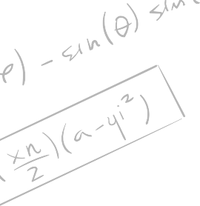

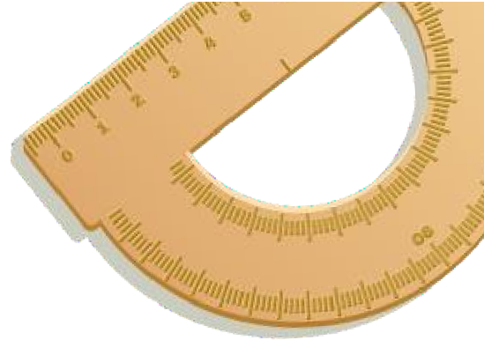



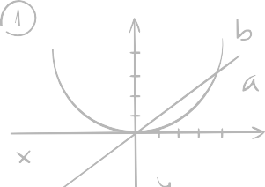

Differential Equation & Coordinate Geometry

Slide 2




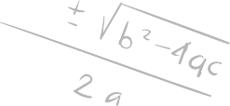
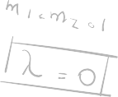

Presented To
Presented By
Md. Rakin Afsar (232002252)
Ashab Uddin
232002274
Torikul Islam
232002270
Junaira Islam
232002246
Nahian Nawal Aroni
232002261
Rukunuzzaman Topu 232002280
Jobayer Ahammad
232002240
Ms. Shamima Islam
Assistant Proffesor Department of CSE
Green University Of Bangladesh

Slide 3
Table of Content
Introduction and Background
Problem Statements
Theoretical Foundations and Methodology
Computational Approach and Implementation
Results and Comparisons
Key Insights and Closing Thoughts

Slide 4

Introduction and Background

Slide 5
Project Overview and Objectives
Real-world problems often exhibit rates of change proportional to the current state.
Exponential growth and decay are foundational concepts in mathematics and science.

Slide 6
Problem Statements

Slide 7
Population Growth Analysis with Proportional Rates
A city's population grows at a rate proportional to its current size.
Initial population: 80,000, increases by 35% in 13 years.
What will the population be in 50 years?

Slide 8
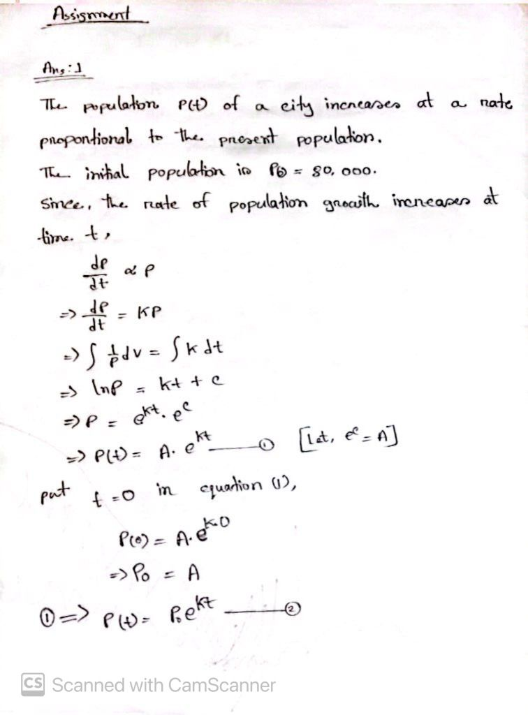
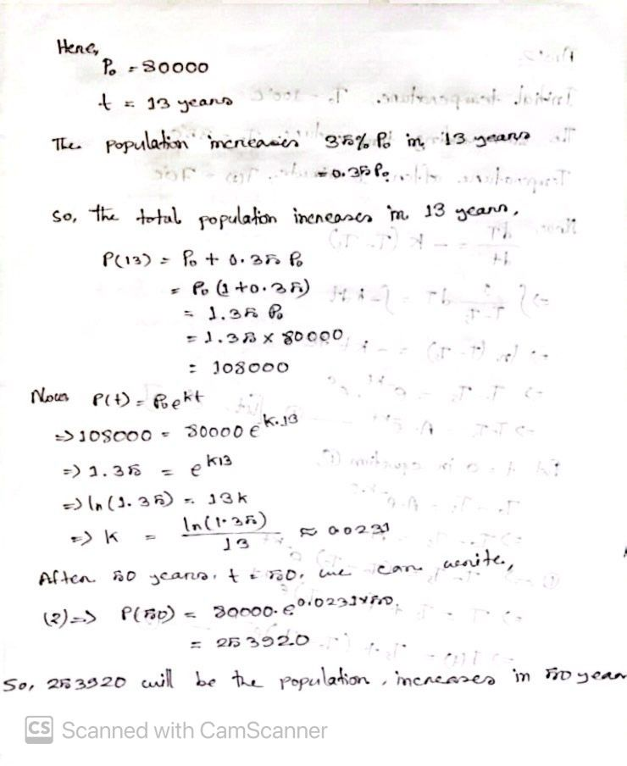

Slide 9

Computational Approach and Implementation
C Implementation
C is an efficient language for numerical computing and solving differential equations.
Demands careful handling of data types and memory.

Slide 10
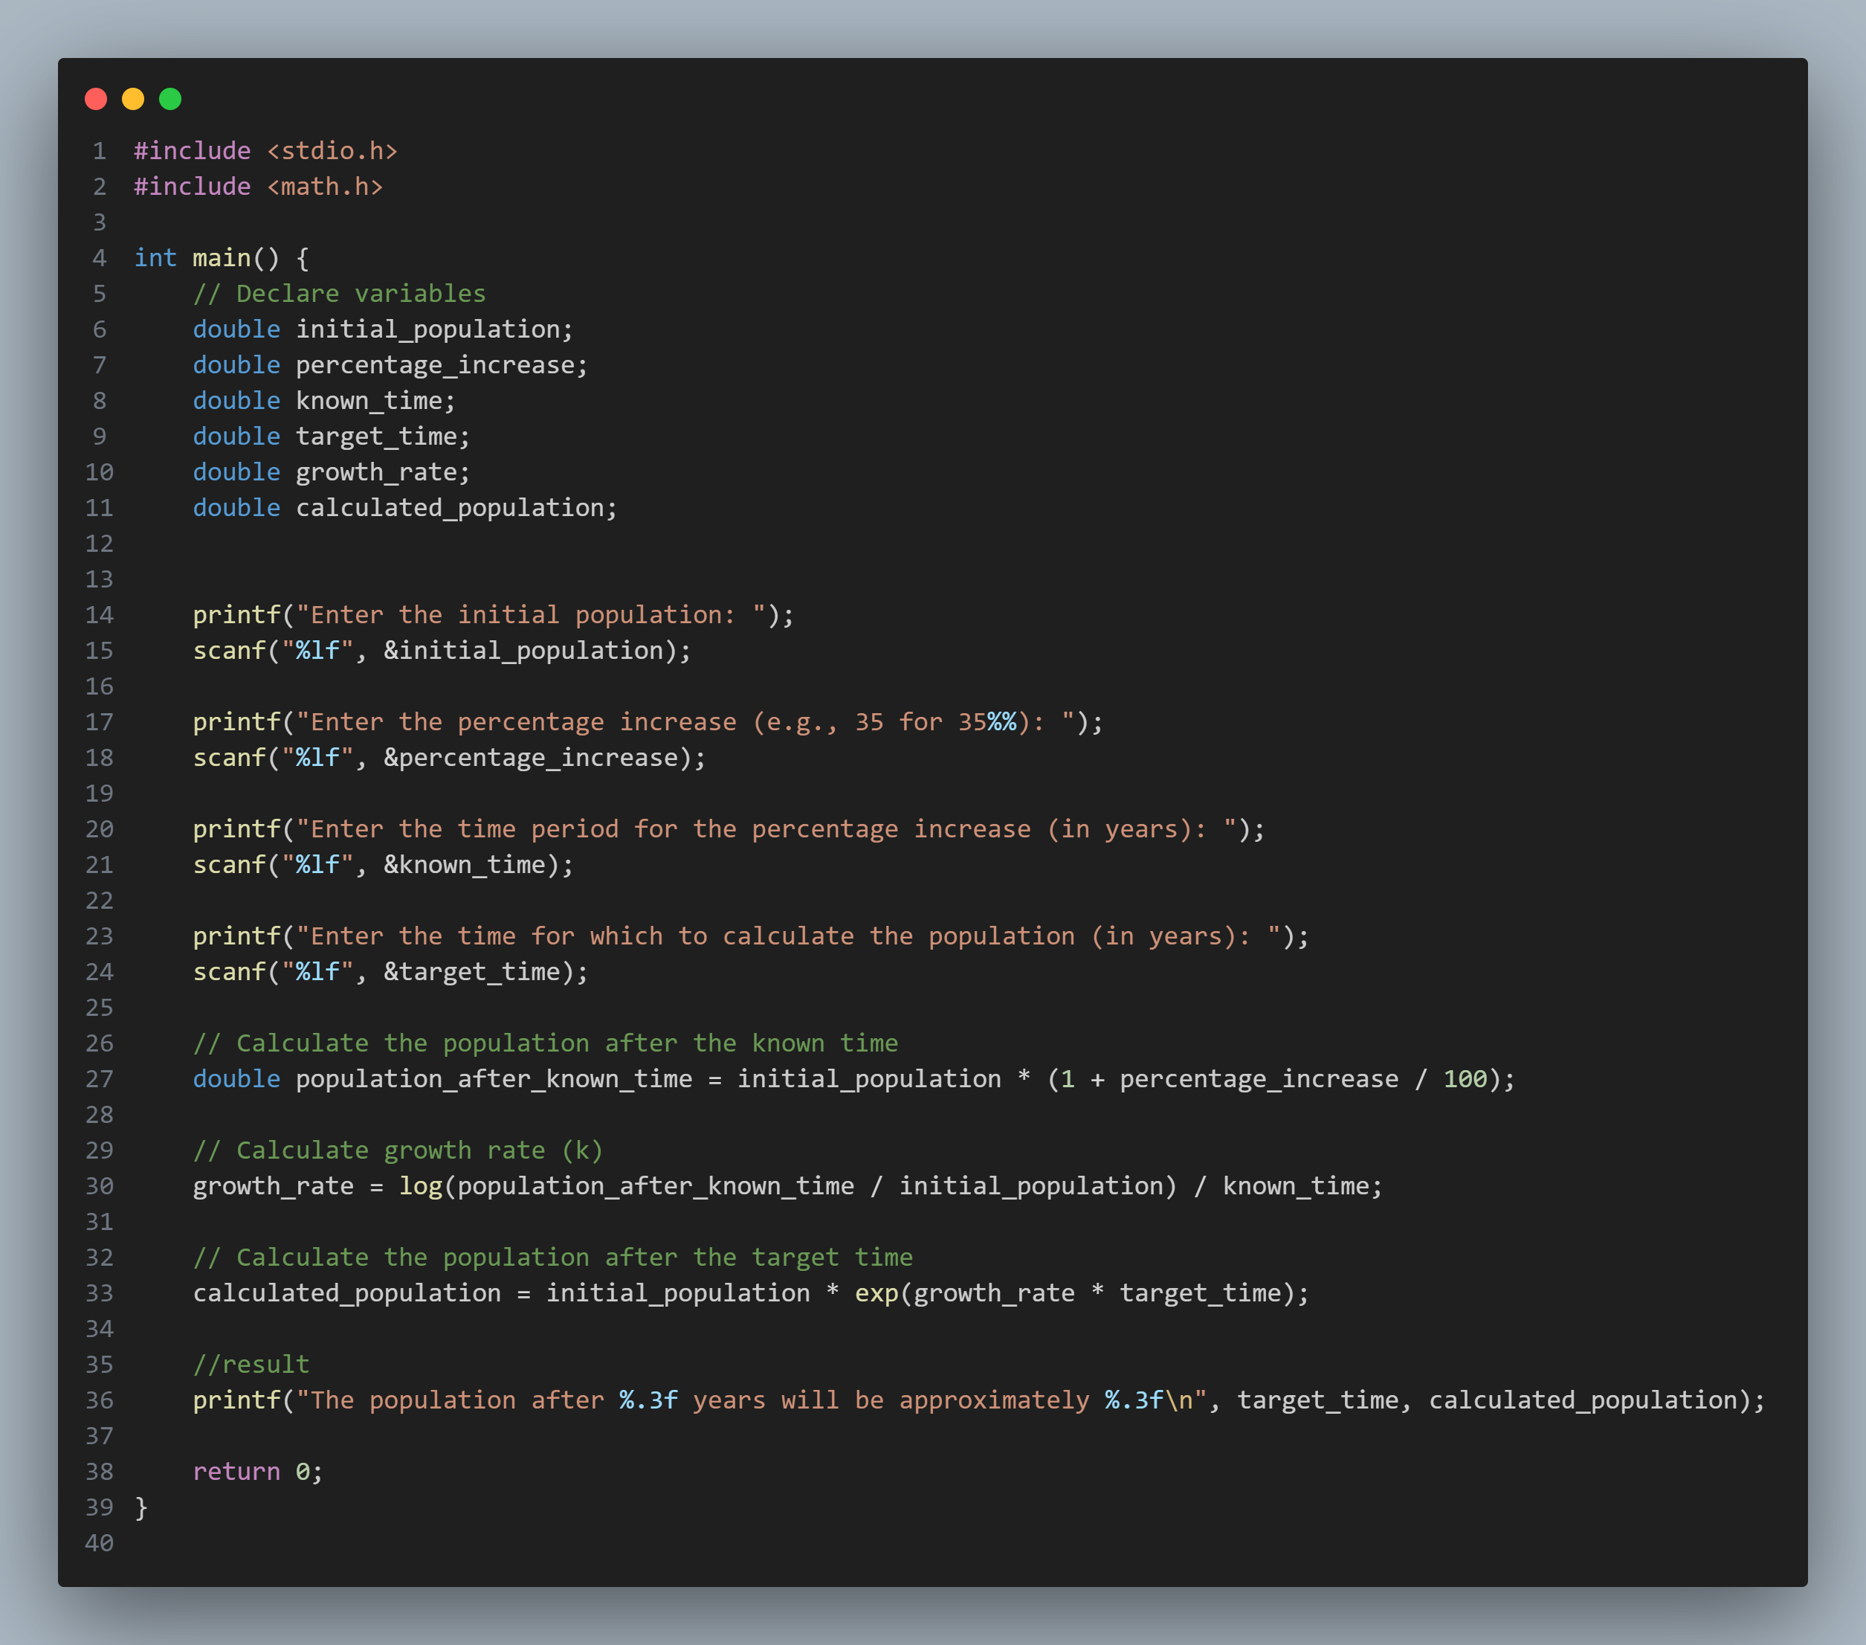

Slide 11
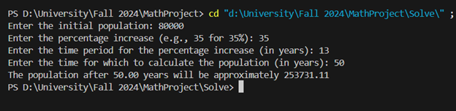

Slide 12
Results and Comparisons
Accuracy : Theoretical solution and the coding implementation both approaches nearly the same result , just a few rounding differences.
Performance: C language worked well with this code.

Slide 13
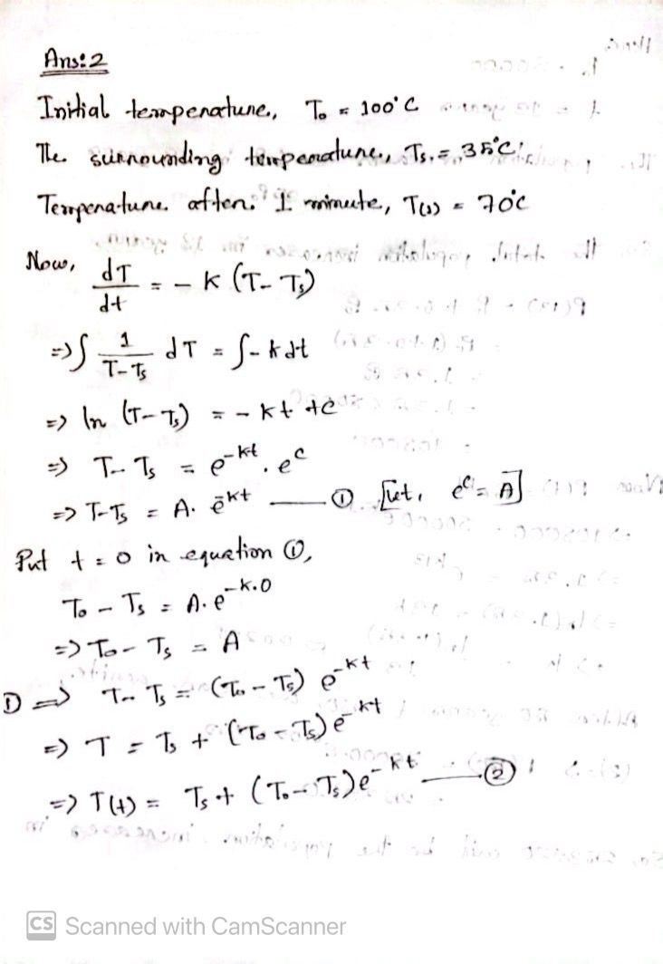
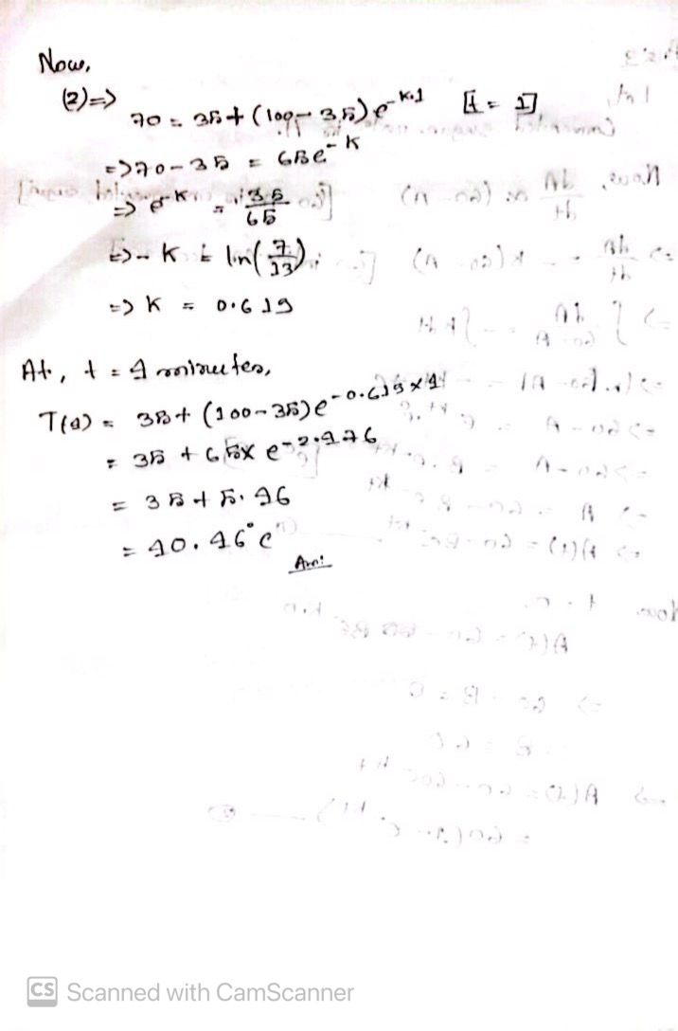
Temperature Decay Over Time
.
A body cools in air at 35°C.
Initially 100°C, cools to 70°C in one minute.
Find its temperature after 4 minutes

Slide 14

Computational Approach and Implementation
Python Implementation
Python is used to numerically solve the differential equations and verify the analytical solutions.
Libraries such as Math are utilized for calculations and visualizations.

Slide 15
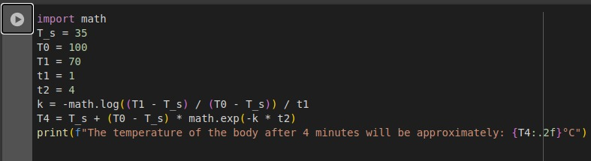

Slide 16
Results and Comparisons
Accuracy : The program code correctly calculates the body temperature, corresponding to 40.46°C calculated by hand after 4 minutes.
Performance : Mathematical models and code implementation ensure well-aligned, consistent and
accurate results.

Slide 17
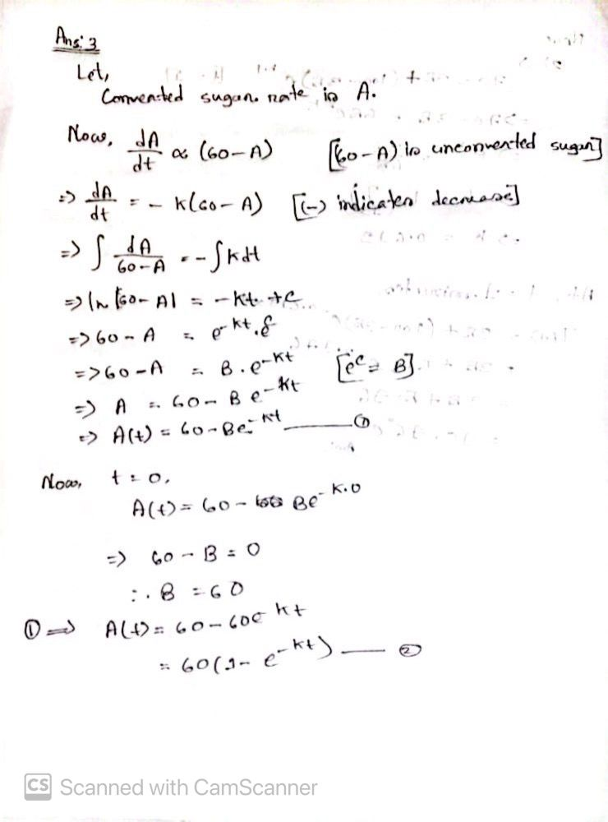
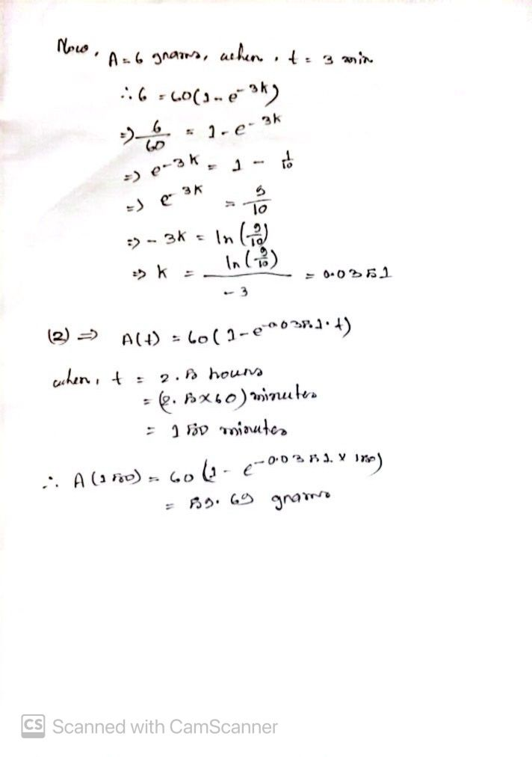
Chemical Conversion Rate of Cane Sugar
Cane sugar converts to dextrose at a proportional rate.
Initial: 60g, 6g converted in 3 minutes.
Amount converted in 2.5 hours?

Slide 18
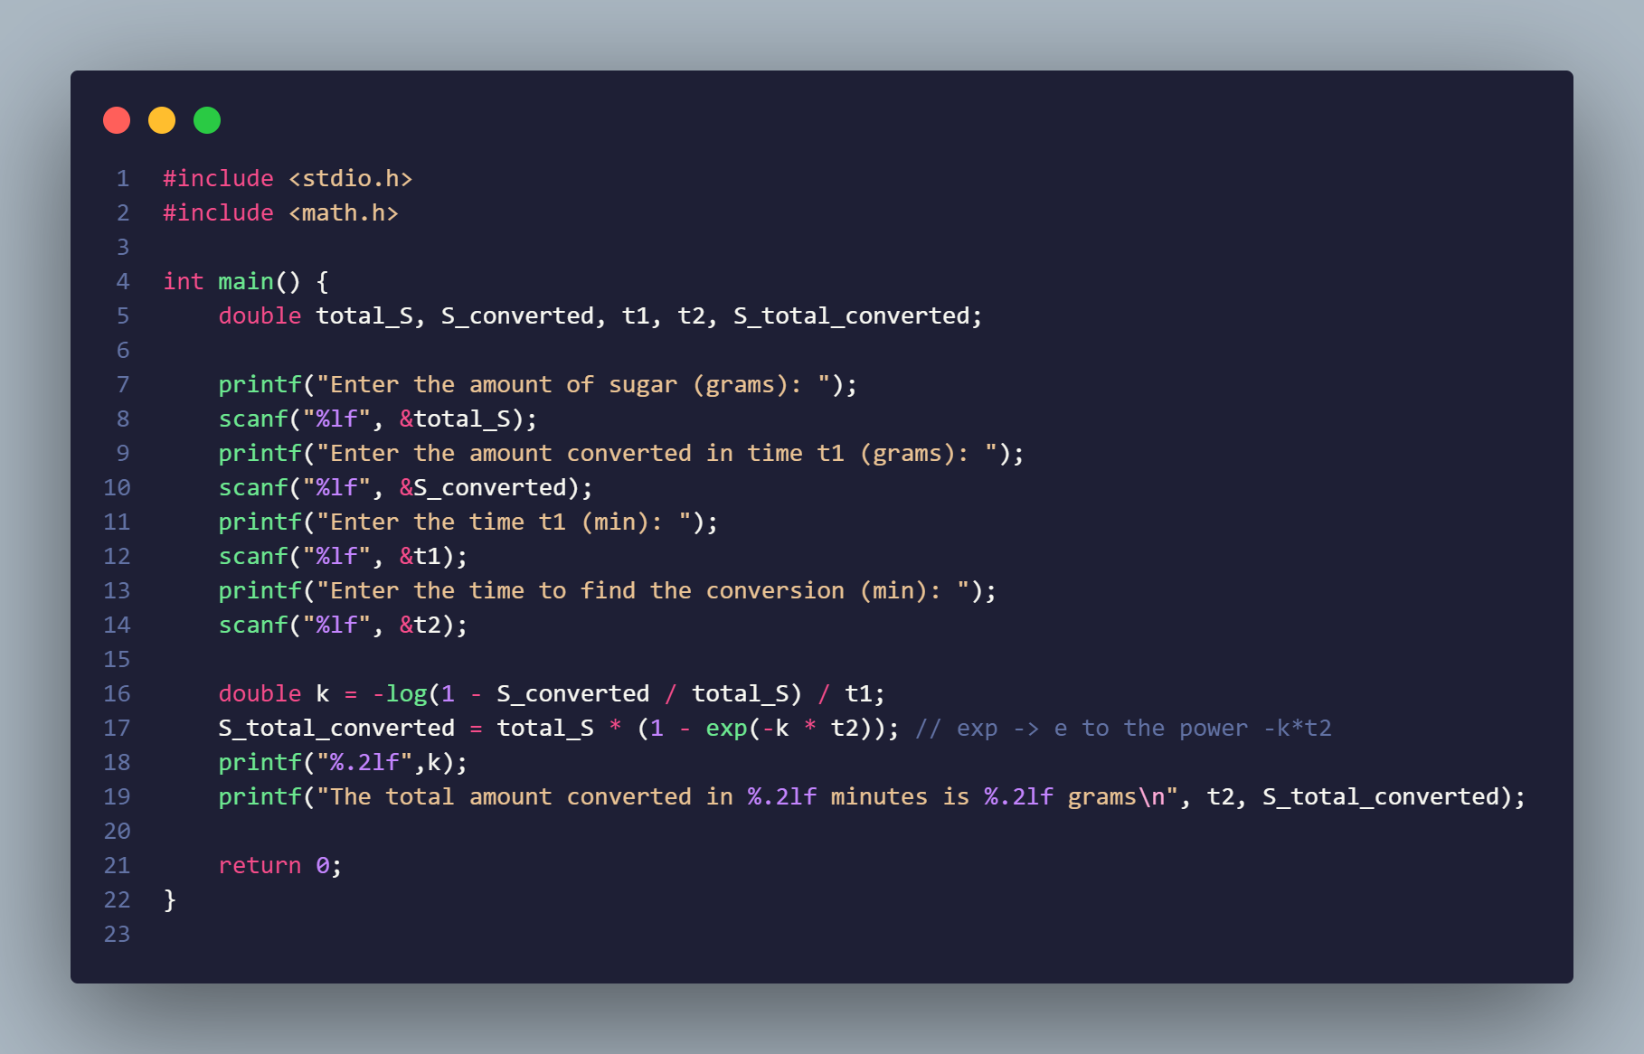

Slide 19
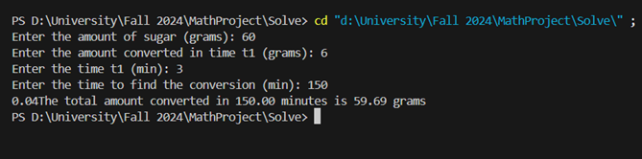

Slide 20
Results and Comparisons
Accuracy : The code precisely matches the mathematical solution
Performance : The outputs align perfectly with hand calculations for all given inputs.

Slide 21
Differential Equation Used
The general equation for exponential growth and decay is where:
is the quantity at time .
is the proportionality constant.

Slide 22
Mathematical Models
Determine constants using given conditions.
Substitute values to predict future behavior.

Slide 23
Key Insights and Closing Thoughts

Slide 24
Key Insights
Exponential models effectively describe natural phenomena.
Growth models aid in planning .
Cooling and decay principles have practical implications in engineering and chemistry.

Slide 25
Closing Thoughts
Understanding these models enhances predictive capabilities.
Encourages further exploration of related real-world applications.

Slide 26
Thank You

